Slide 1
Team 3 - Project 3
Cole Dombrowski, Franklin Xie, James “Thomas” Seeley

Slide 2
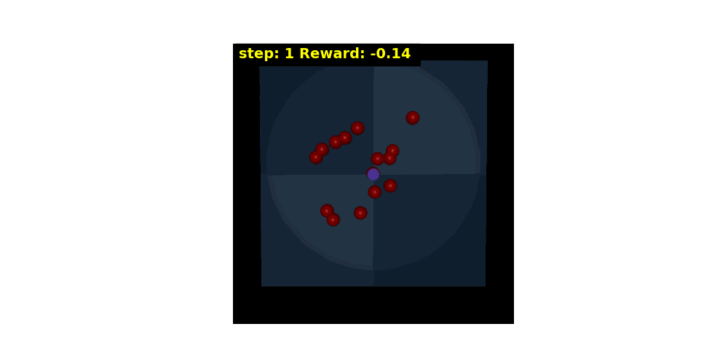
Poor Performance (Initial Poor Player):

Slide 3
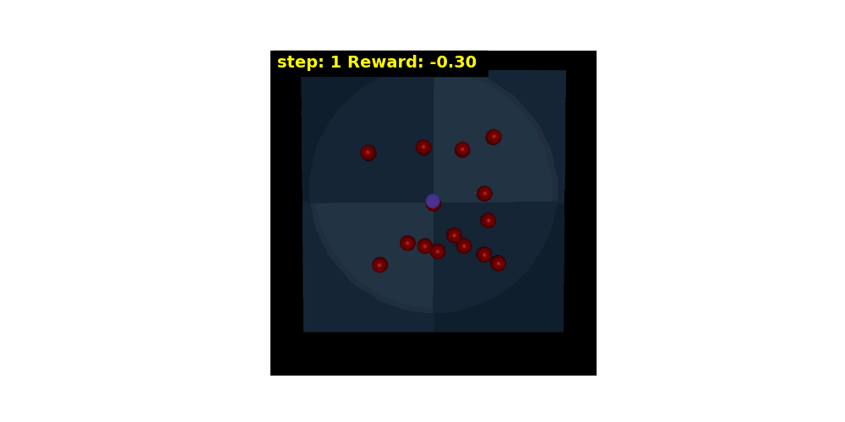
Moderate Performance:

Slide 4
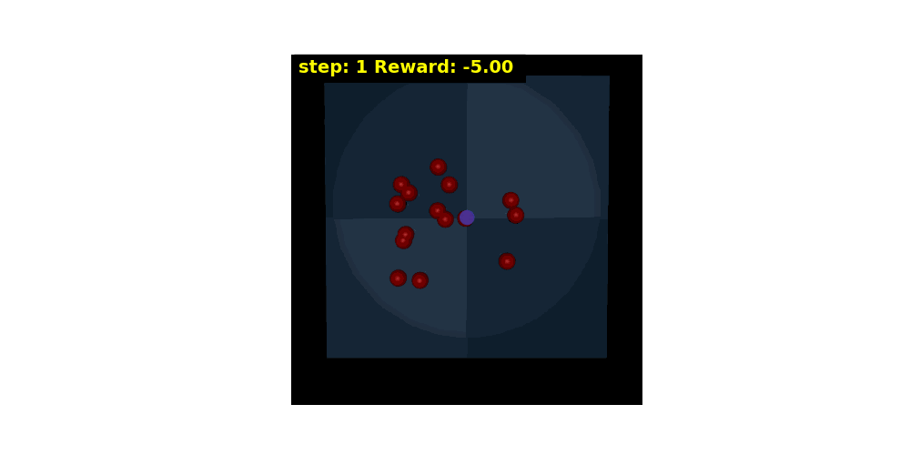
Better Performance:

Slide 5
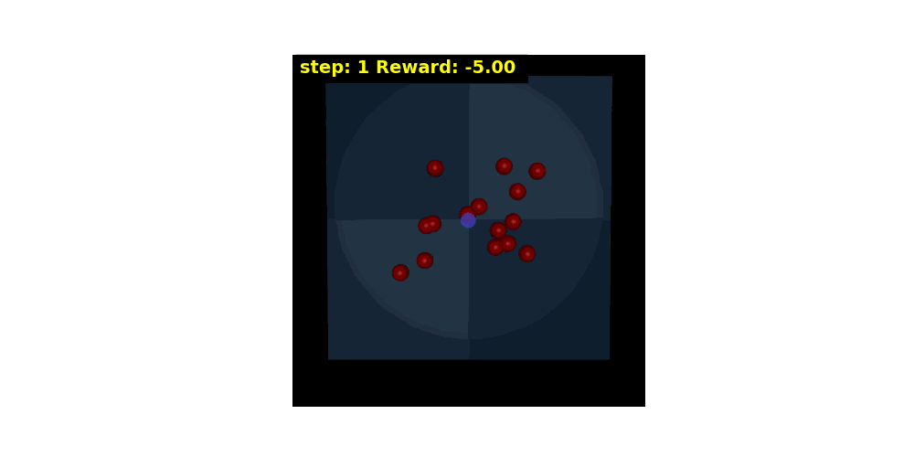
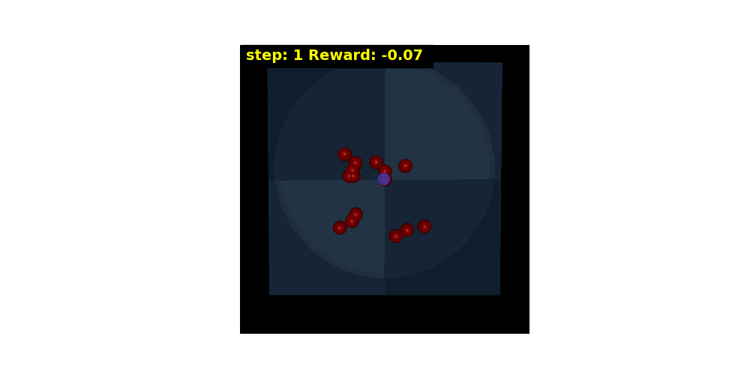
Common errors:

Slide 6
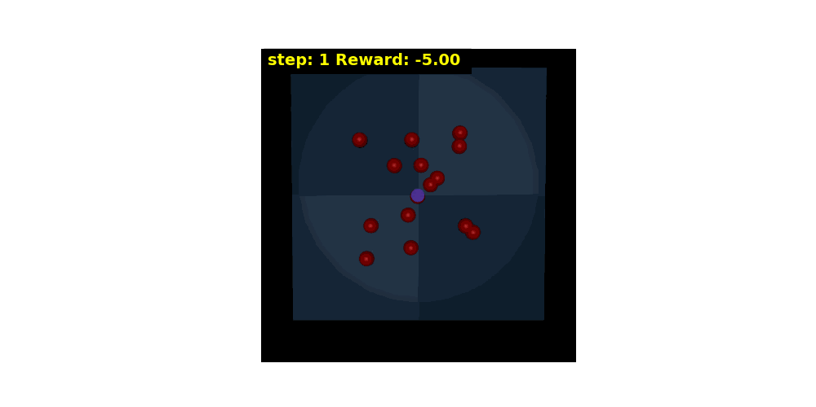
Best Performance (1 puck left):

Slide 7
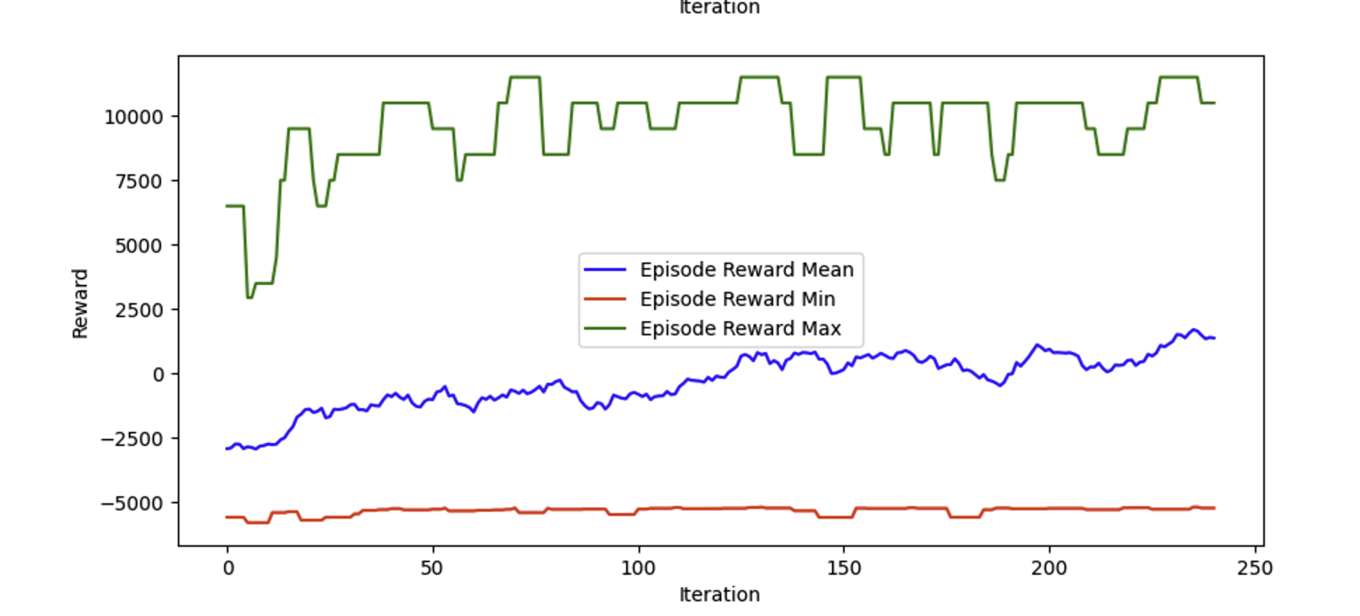
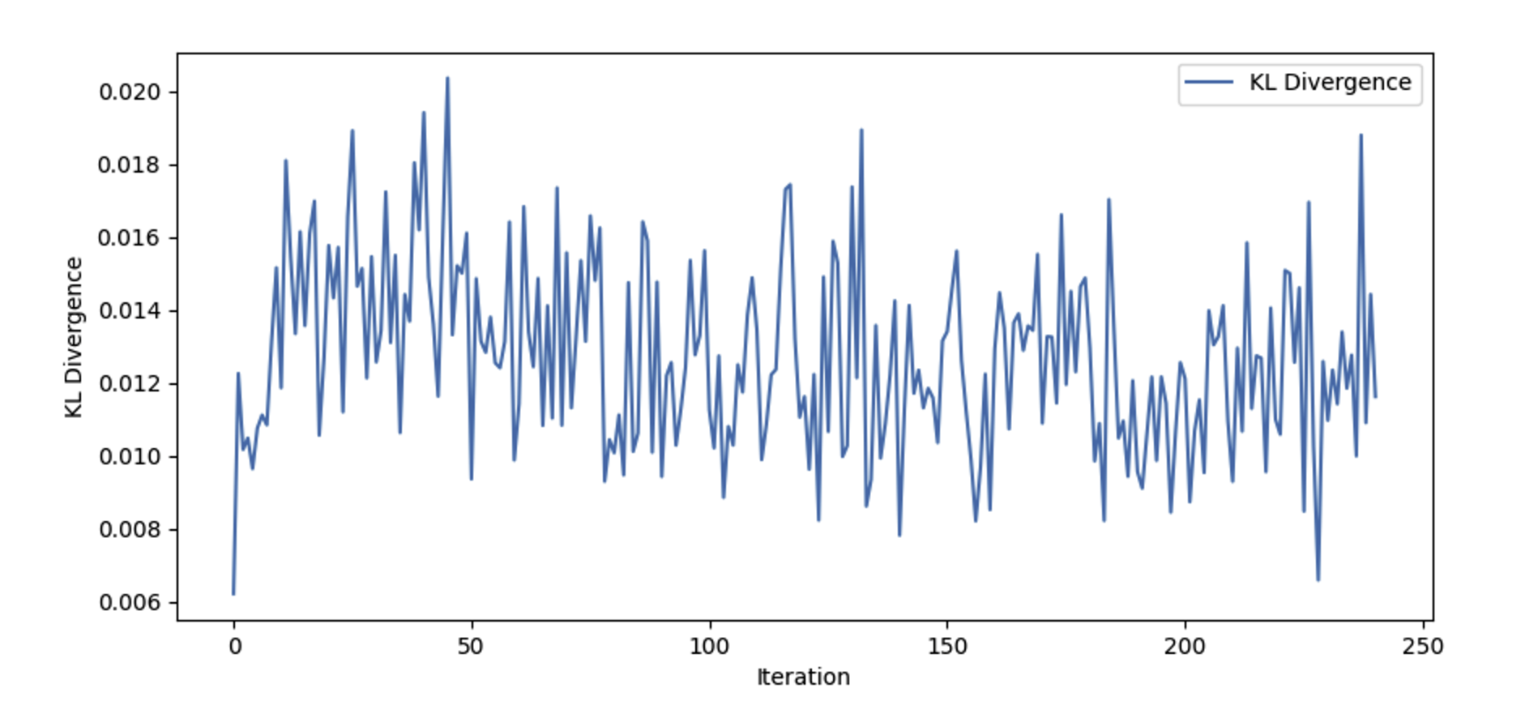
KL Divergence/Reward - Training Progress (best performance):

Slide 8
Reflections/Summary:
Trained the agent for 250 iterations while focusing on rewards and observation space simplification
Overcame challenges like random movement, overshooting, and pucks moving without contact
The agent efficiently targeted and cleared pucks while staying in bounds

